Slide 1
Pandas.
Week 12 | Lecture 1 (12.1)

Slide 2
This Week’s Content
Lecture 12.1
Pandas.
Lecture 12.2
More Pandas, Data Visualization.
Lecture 12.3
Design Problem: Stock Market – Part 1

Slide 3
The csv Module.
Remember the csv module from last week?
Let’s see how we can use it to work with a dataset of past presidential elections in the United States.
Open your notebook
Click Link:
1. The csv module

Slide 4

Pandas.
What is Pandas?

Slide 5
Pandas.
What is Pandas?
These are Pandas.

Slide 6
Pandas.
What else is Pandas?
A fast, powerful, flexible and easy to use open-source data analysis and manipulation tool, built on top of the Python programming language.
Pandas stands for “Python Data Analysis Library”.

Slide 7
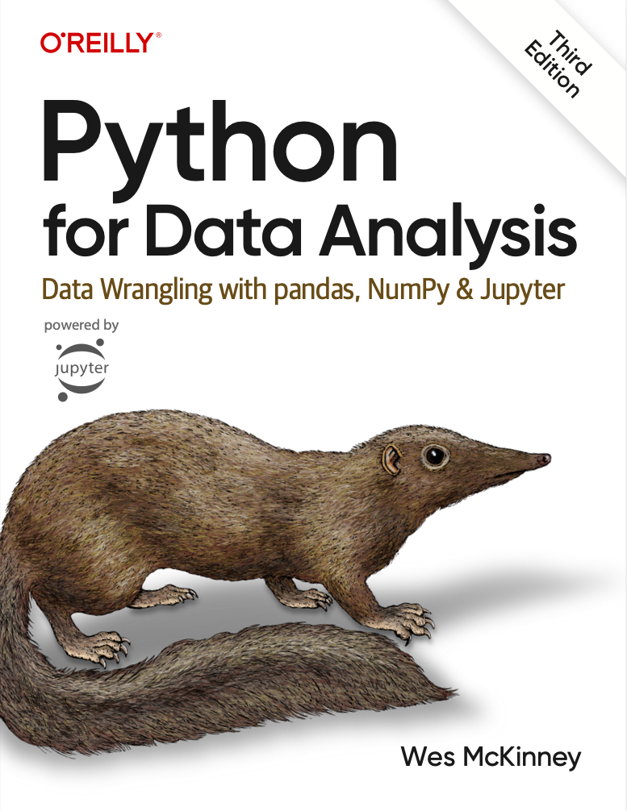
Pandas.
You have free access to a fantastic book by the creator of Pandas!
Click here.
This is not an official course resource but could come in handy beyond APS106.
Some more free content here at Kaggle Courses.

Slide 8
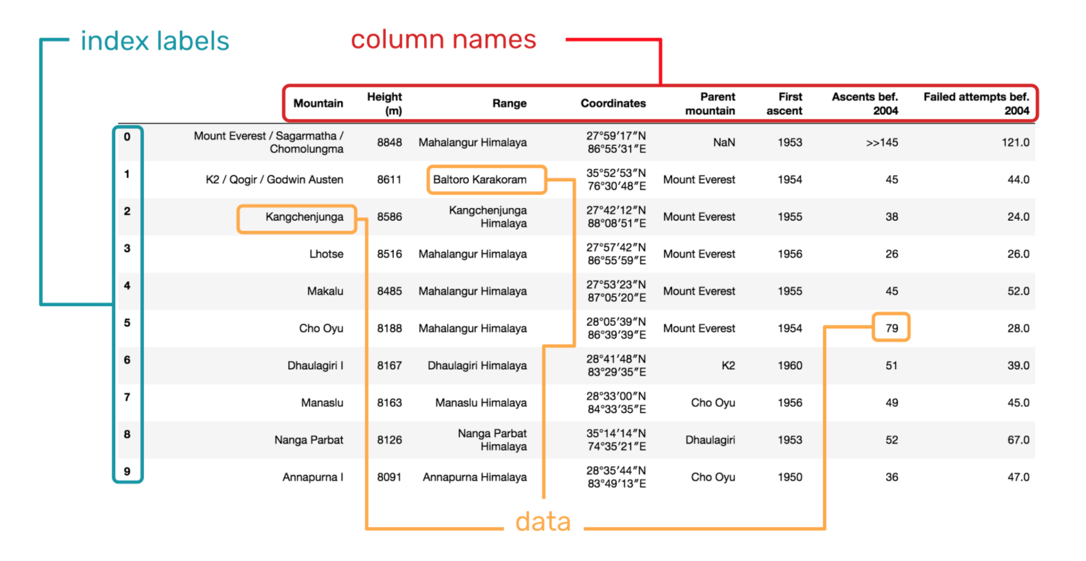
DataFrames.
In the language of Pandas, we call a table a DataFrame.
A DataFrame is a 2-dimensional labeled data structure with columns of potentially different types.
Matrix?
You can think of it like a spreadsheet.
DataFrames were first introduced in the R Programming Language and are generally the most used Pandas object.

Slide 9
DataFrames.
In the language of Pandas, we call a table a DataFrame.
A DataFrame is a 2-dimensional labeled data structure with columns of potentially different types.
Matrix?
You can think of it like a spreadsheet.
DataFrames were first introduced in the R Programming Language and are generally the most used Pandas object.
Open your notebook
Click Link:
2. DataFrames

Slide 10
Series.
Open your notebook
Click Link:
3. Series

Slide 11
DataFrames.
Open your notebook
Click Link:
4. Indices

Slide 12
DataFrames.
Open your notebook
Click Link:
5. Data Extraction

Slide 13
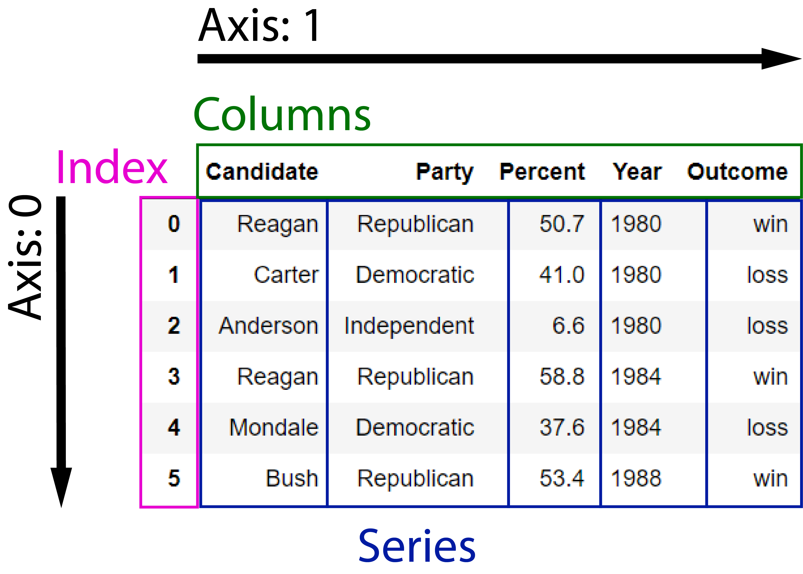
Data Structures
Dataset
U.S. Election Results.
There are three fundamental data structures in pandas:
Data Frame: 2D data tabular data.
Series: 1D data. We can think of Series as columnar data.
Index: A sequence of row labels.

Slide 14
Data Structures
DataFrames
There are three fundamental data structures in pandas:
Data Frame: 2D data tabular data.
Series: 1D data. We can think of Series as columnar data.
Index: A sequence of row labels.

Slide 15
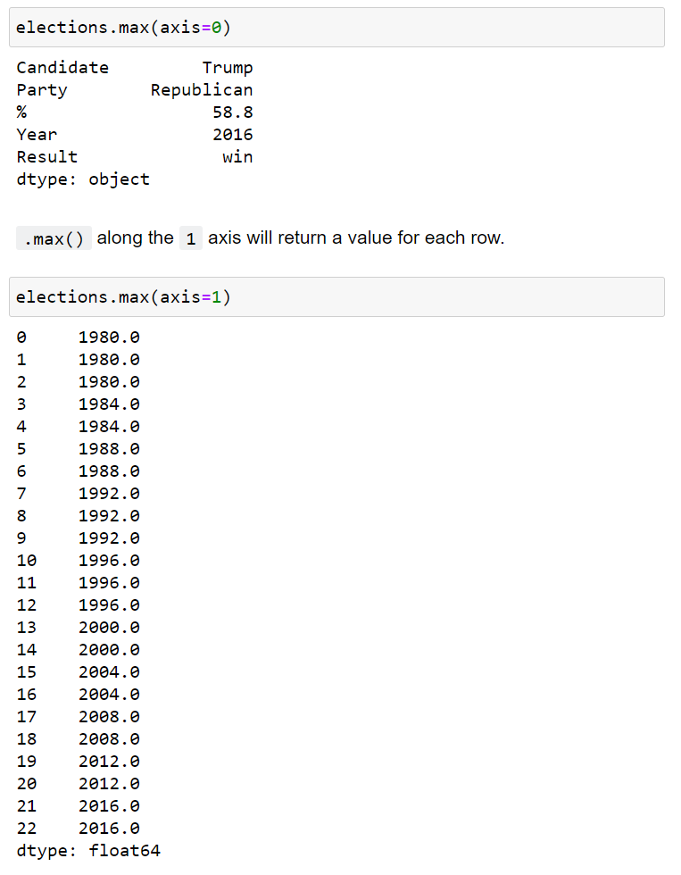
Data Structures
Axis 0
Column-wise
There are three fundamental data structures in pandas:
Data Frame: 2D data tabular data.
Series: 1D data. We can think of Series as columnar data.
Index: A sequence of row labels.
Axis 1
Row-wise

Slide 16
Data Structures
Series
We can think of a Data Frame as a collection of Series that all share the same Index.
There are three fundamental data structures in pandas:
Data Frame: 2D data tabular data.
Series: 1D data. We can think of Series as columnar data.
Index: A sequence of row labels.
Candidate
Series
Party
Series
Percent
Series
Outcome
Series
Year
Series

Slide 17
Data Structures
Series
We can think of a Data Frame as a collection of Series that all share the same Index.
There are three fundamental data structures in pandas:
Data Frame: 2D data tabular data.
Series: 1D data. We can think of Series as columnar data.
Index: A sequence of row labels.
Candidate
Series

Slide 18
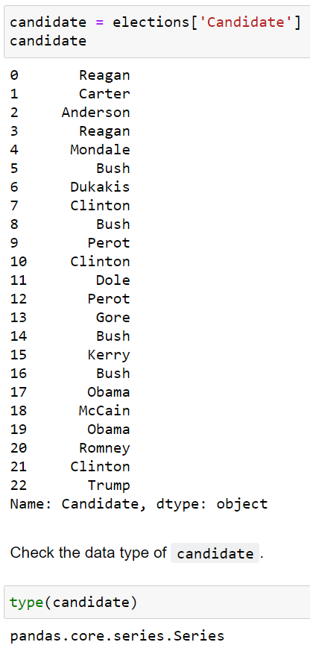
Data Structures
There are three fundamental data structures in pandas:
Data Frame: 2D data tabular data.
Series: 1D data. We can think of Series as columnar data.
Index: A sequence of row labels.

Slide 19
Data Structures
Index
There are three fundamental data structures in pandas:
Data Frame: 2D data tabular data.
Series: 1D data. We can think of Series as columnar data.
Index: A sequence of row labels.
Index

Slide 20
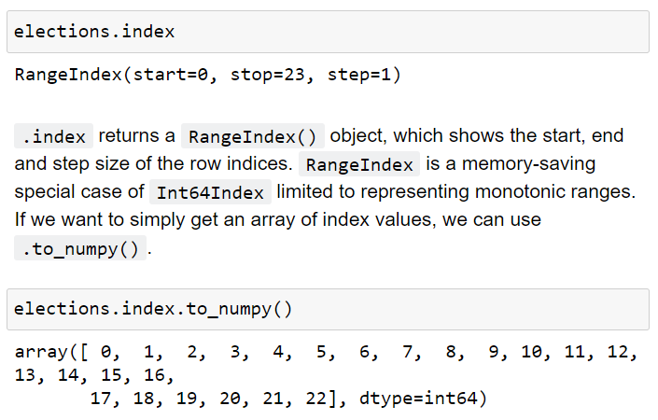
Data Structures
There are three fundamental data structures in pandas:
Data Frame: 2D data tabular data.
Series: 1D data. We can think of Series as columnar data.
Index: A sequence of row labels.

Slide 21
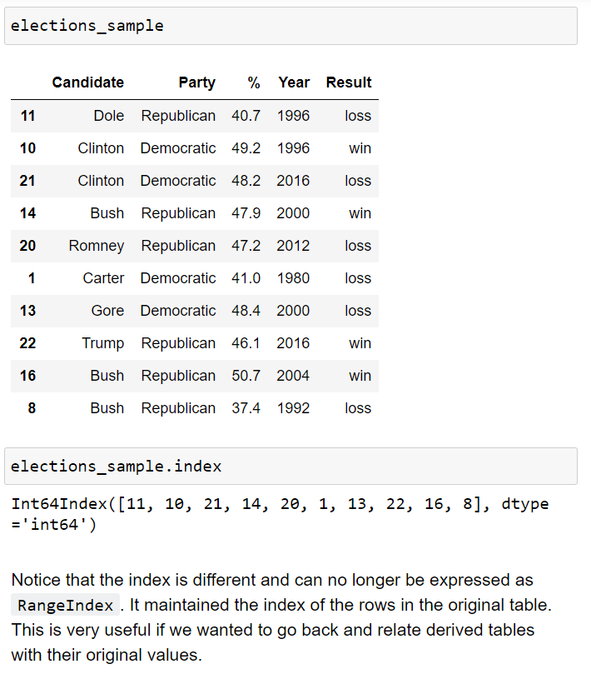
Data Structures
There are three fundamental data structures in pandas:
Data Frame: 2D data tabular data.
Series: 1D data. We can think of Series as columnar data.
Index: A sequence of row labels.

Slide 22
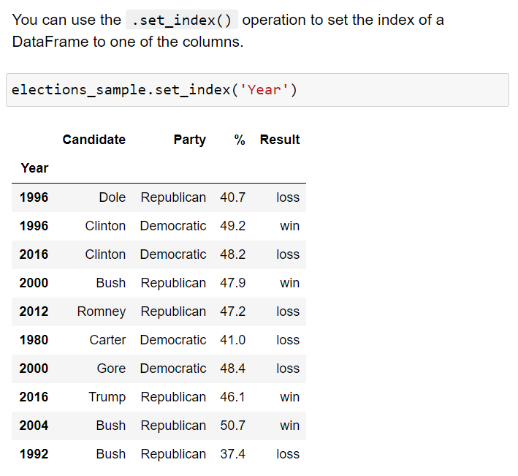
Data Structures
There are three fundamental data structures in pandas:
Data Frame: 2D data tabular data.
Series: 1D data. We can think of Series as columnar data.
Index: A sequence of row labels.
Indices (row labels) can also:
be non-numeric
have a name (e.g. “Year”).

Slide 23
Data Structures
There are three fundamental data structures in pandas:
Data Frame: 2D data tabular data.
Series: 1D data. We can think of Series as columnar data.
Index: A sequence of row labels.
Indices (row labels) do not have to be unique.

Slide 24
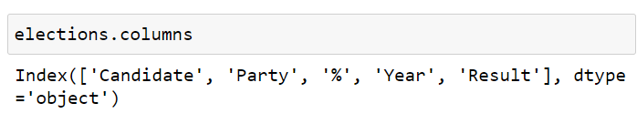
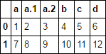
Data Structures
There are three fundamental data structures in pandas:
Data Frame: 2D data tabular data.
Series: 1D data. We can think of Series as columnar data.
Index: A sequence of row labels.
Columns (Series names).
Column names in Pandas are almost always unique!
You really shouldn’t have two columns named “Candidate”.

Slide 25
Pandas I
DataFrames
Pandas Data Structures
Importing Data
Indexing
Utility Methods

Slide 26
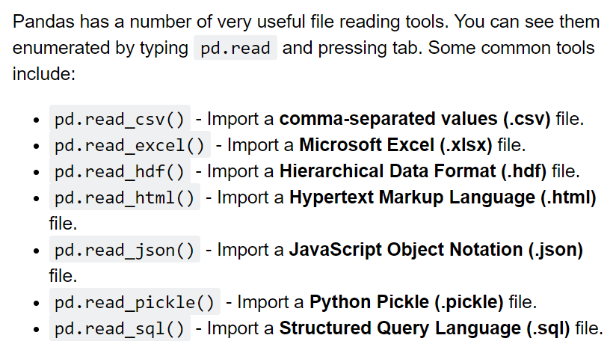
Importing Data
Pandas has a number of useful functions for importing data from common formats.

Slide 27
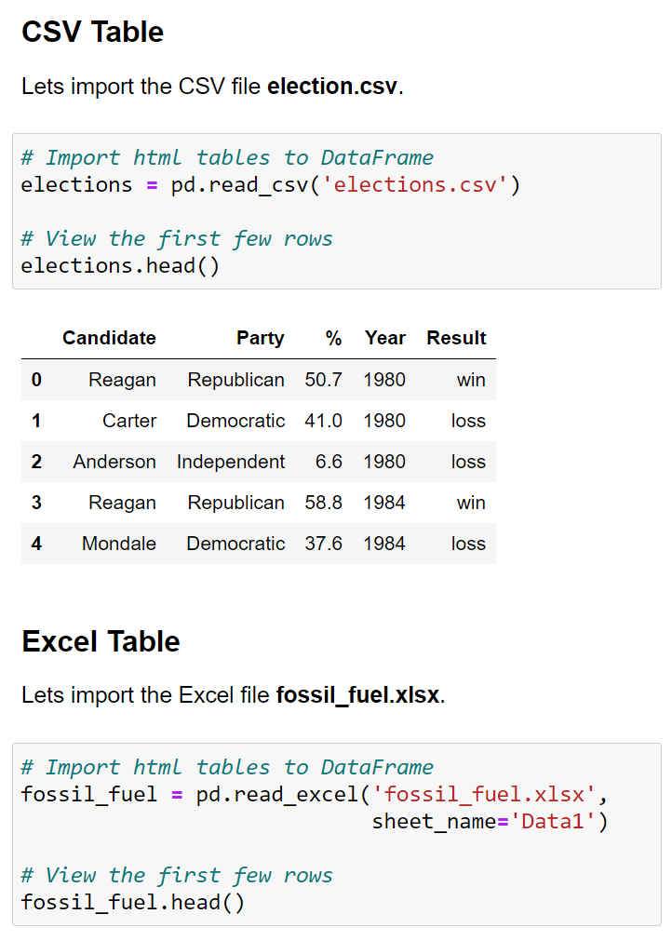
Importing Data
Pandas has a number of useful functions for importing data from common formats.
To get a quick look at the first 5 rows of a DataFrame, use the .head() method.

Slide 28
Pandas I
DataFrames
Pandas Data Structures
Importing Data
Indexing
Utility Methods

Slide 29
Indexing
There are many ways to access rows and columns of a Pandas DataFrame.
We will spend some time reviewing the most used options.
.loc[]
Boolean Array Selection
.iloc[]

Slide 30
Indexing
There are many ways to access rows and columns of a Pandas DataFrame.
We will spend some time reviewing the most used options.
.loc[]
Boolean Array Selection
.iloc[]

Slide 31
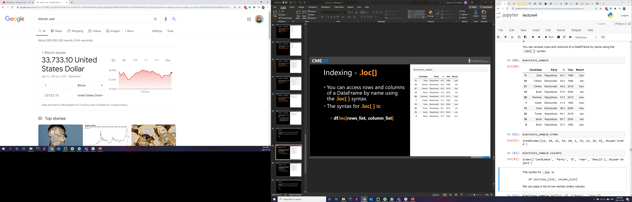
Indexing - .loc[]
You can access rows and columns of a DataFrame by name using the .loc[ ] syntax.
The syntax for .loc[ ] is:
df.loc[rows_list, column_list]

Slide 32
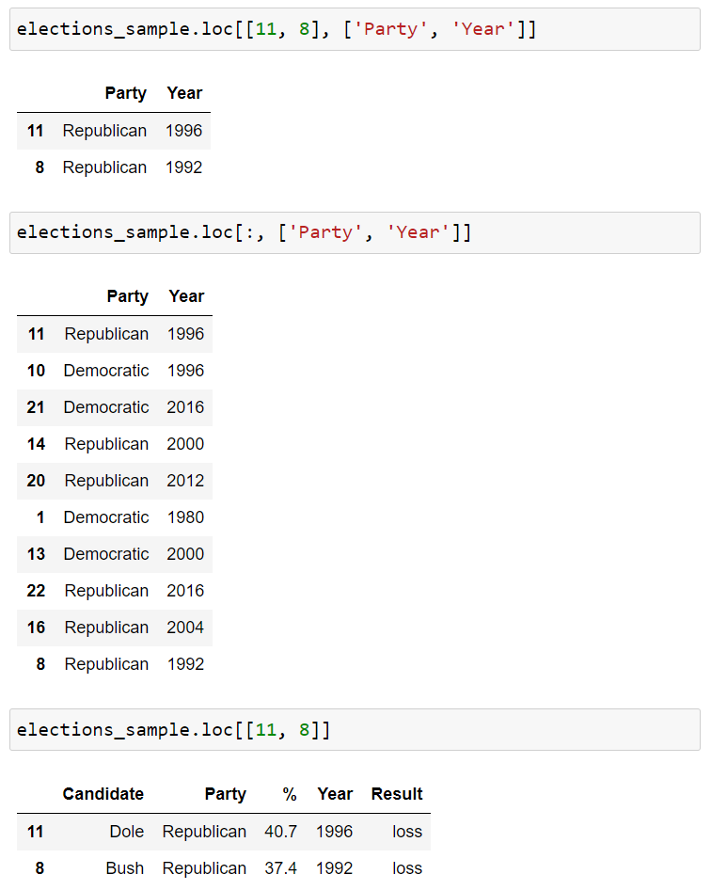
Indexing - .loc[]
You can access rows and columns of a DataFrame by name using the .loc[ ] syntax.
The syntax for .loc[ ] is:
df.loc[rows_list, column_list]

Slide 33
Indexing - .loc[]
You can access rows and columns of a DataFrame by name using the .loc[ ] syntax.
The syntax for .loc[ ] is:
df.loc[rows_list, column_list]
Range Slicing [0:10] works with .loc[] but only when the index is monotonic increasing or decreasing.
Will it work for elections_sample?

Slide 34
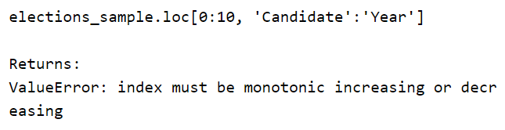
Indexing - .loc[]
You can access rows and columns of a DataFrame by name using the .loc[ ] syntax.
The syntax for .loc[ ] is:
df.loc[rows_list, column_list]
Range Slicing [0:10] works with .loc[] but only when the index is monotonic increasing or decreasing.
Will it work for elections_sample?

Slide 35

Indexing - .loc[]
You can access rows and columns of a DataFrame by name using the .loc[ ] syntax.
The syntax for .loc[ ] is:
df.loc[rows_list, column_list]
If you give .loc[] single scalar arguments for the requested rows and columns, you get back just a single value.

Slide 36
Indexing
There are many ways to access rows and columns of a Pandas DataFrame.
We will spend some time reviewing the most used options.
.loc[]
Boolean Array Selection
.iloc[]

Slide 37

Indexing – Boolean Array Selection
[ ] and .loc[ ] support arrays of Booleans as an input.
In this case, the array must be exactly as long as the number of rows or columns.
The result is a filtered version of the DataFrame, where only rows corresponding to True appear.
This functionality is similar to WHERE in SQL.

Slide 38
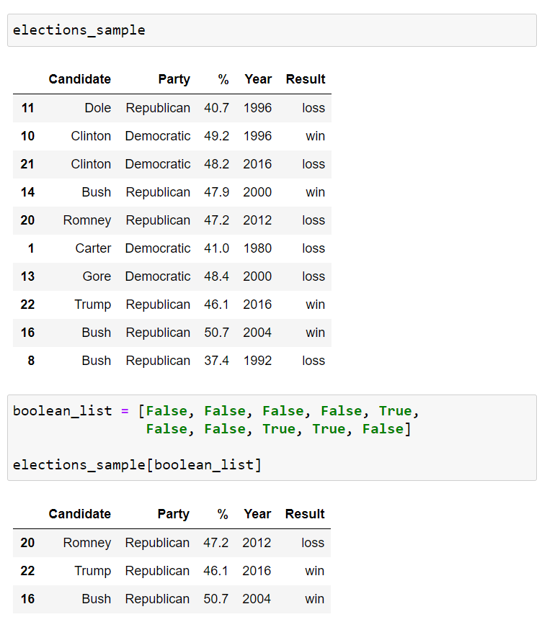
Indexing – Boolean Array Selection
.loc[ ] supports arrays of Booleans as an input.
In this case, the array must be exactly as long as the number of rows or columns.
The result is a filtered version of the DataFrame, where only rows corresponding to True appear.
This functionality is similar to WHERE in SQL.

Slide 39
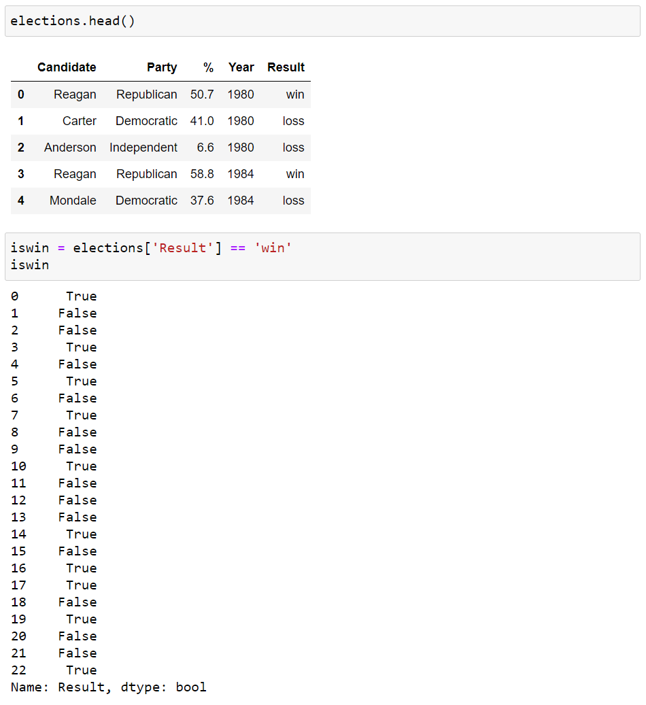
Indexing – Boolean Array Selection
One very common task in Data Science is filtering.
Boolean Array Selection is one way to achieve this in Pandas.
We start by observing logical operators like the equality operator == can be applied to Pandas Series data to generate a Boolean array.
For example, we can compare the Result column to the String ‘win’.

Slide 40
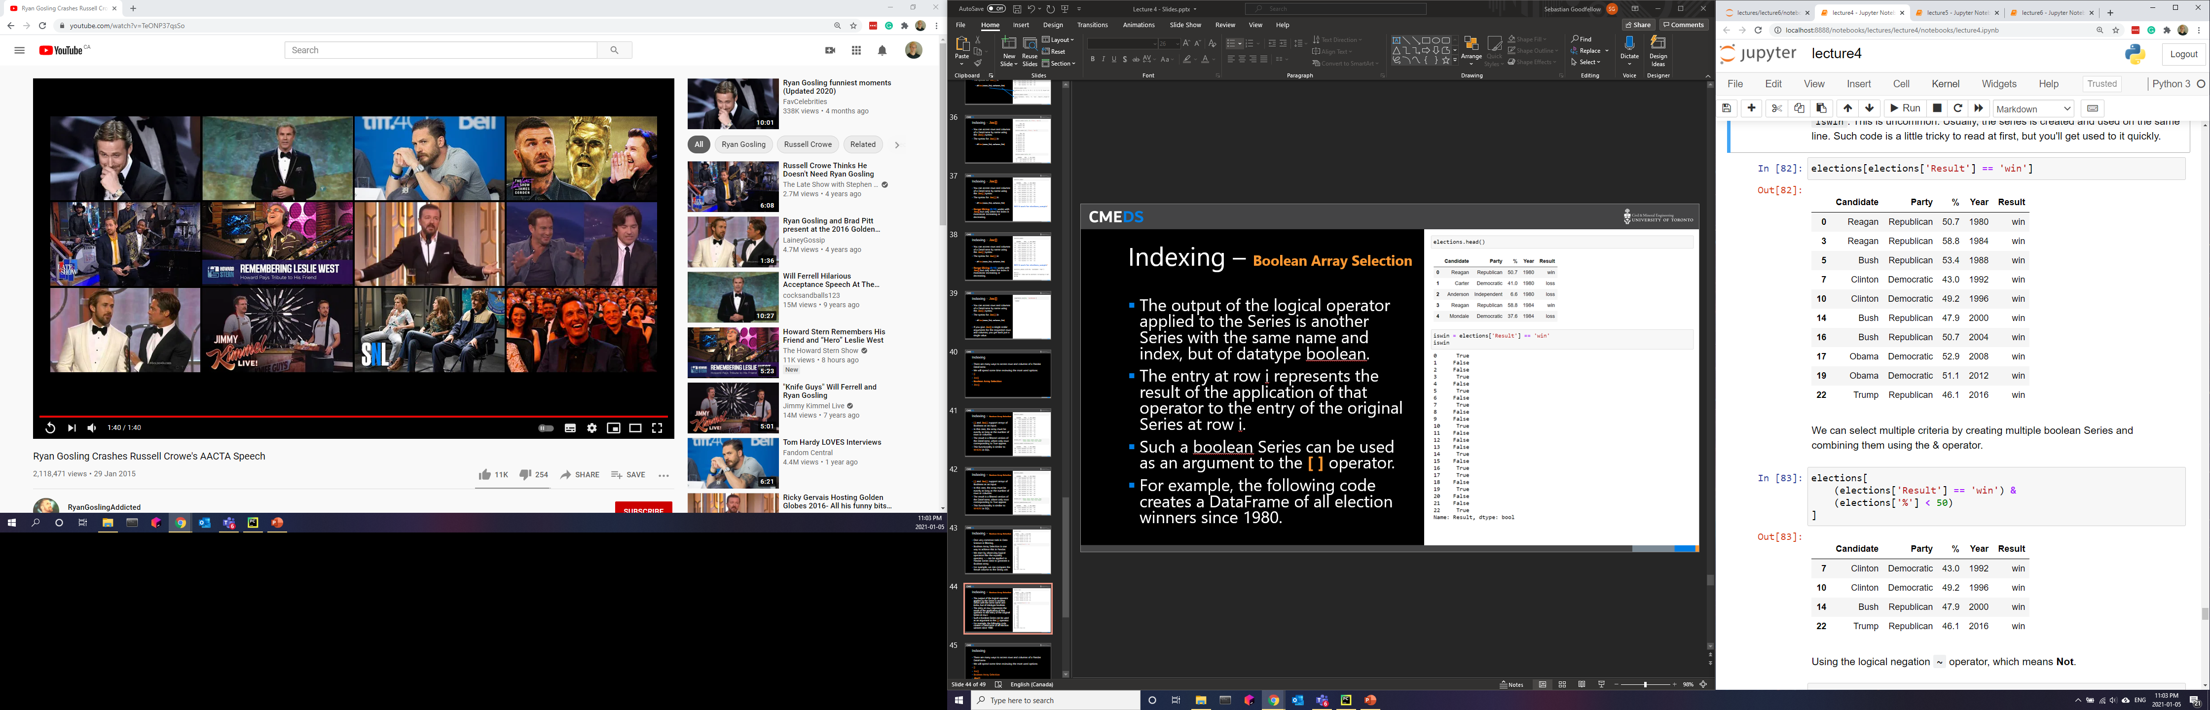
Indexing – Boolean Array Selection
The output of the logical operator applied to the Series is another Series with the same name and index, but of datatype Boolean.
The entry at row i represents the result of the application of that operator to the entry of the original Series at row i.
Such a Boolean Series can be used as an argument to the [ ] operator.

Slide 41
Indexing – Boolean Array Selection
We can select multiple criteria by creating multiple Boolean Series and combining them using the & operator.
Using the logical negation ~ operator, which means Not.
~(elections['%'] < 50)
You can also use the | operator, which mean Or.

Slide 42
Indexing
There are many ways to access rows and columns of a Pandas DataFrame.
We will spend some time reviewing the most used options.
[]
.loc[]
Boolean Array Selection
.iloc[]

Slide 43
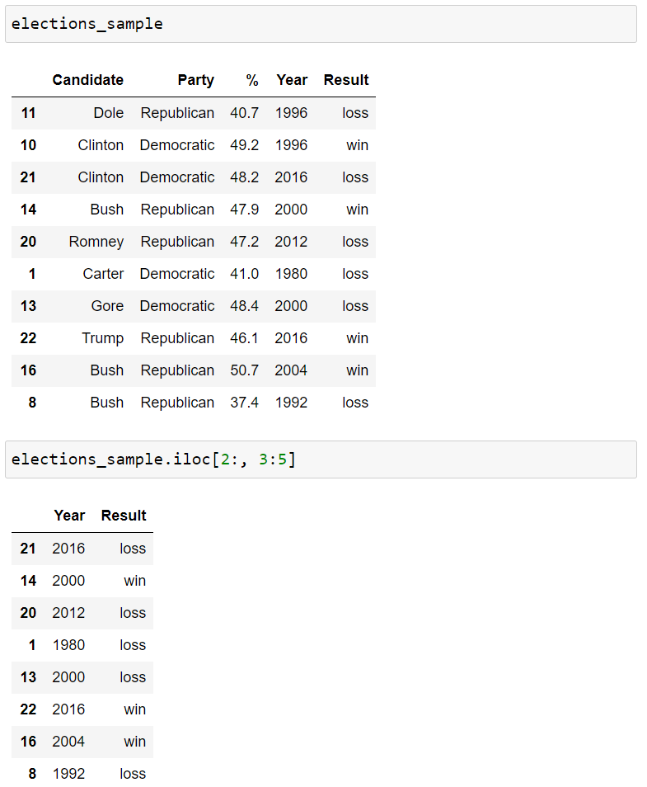
Indexing - .iloc()
0
1
2
3
4
0
1
.loc's cousin iloc is very similar, but is used to access based on numerical position instead of label.
For example, to access to the first 3 rows and first 3 columns of a table, we can use .iloc[0:3, 0:3].
.iloc slicing is exclusive, just like standard Python slicing of numerical values.
2
3
4
5
6
7
8
9

Slide 44
Indexing
We will use both .loc[] and .iloc[] in the course.
.loc[] is generally preferred for a number of reasons, for example:
It is harder to make mistakes since you have to literally write out what you want to get.
Code is easier to read, because the reader doesn't have to know e.g. what column #31 represents.
It is robust against permutations of the data, e.g. the database admit switches the order of two columns.

Slide 45
Pandas I
DataFrames
Pandas Data Structures
Importing Data
Indexing
Utility Methods

Slide 46
Utility Methods
Pandas has number of very useful helper methods.

Slide 47
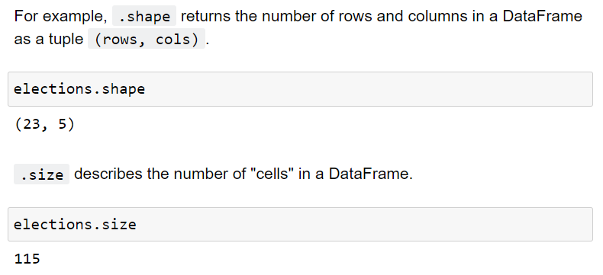
Utility Methods
.shape
.size

Slide 48
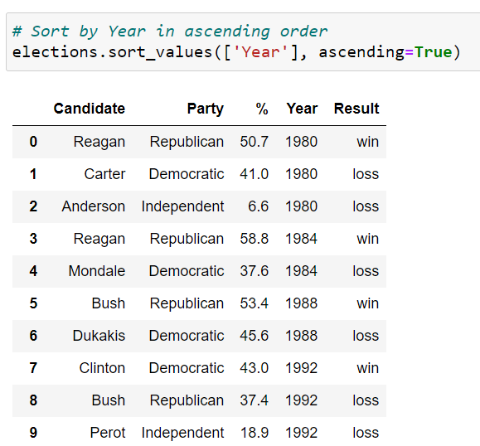
Utility Methods
.sort_values()

Slide 49
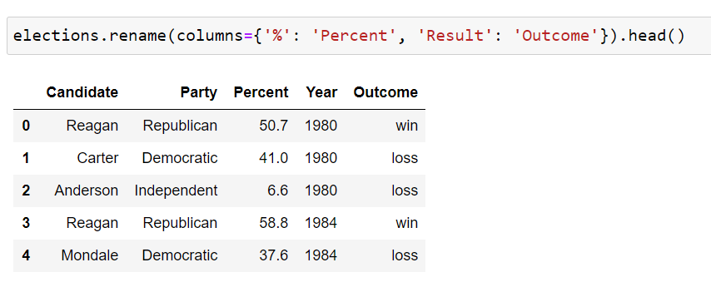
Utility Methods
.rename()

Slide 50
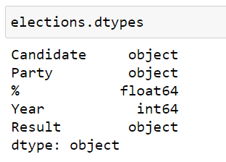
Utility Methods
.dtypes

Slide 51
Utility Methods
.describe()
.info()
.unique()
.value_count()
.astype()
Many, many, many more.

Slide 52
Pandas.
Week 12 | Lecture 1 (12.1)

